Slide 1
Based on the Commission Proposal for Horizon Europe, the common understanding between co-legislators and the Partial General Approach, both approved in April 2019

Slide 2
Communication, Dissemination and Exploitation (D&E), Key Impact Pathways indicators and Open access to data and publications in Horizon Europe
Regional Stakeholder Workshop on Horizon Europe implementation
Ruse, Bulgaria
22 January 2020

Slide 3
Requirements for Communication,
Dissemination & Exploitation

Slide 4
What are project results?
Key definitions
Research roadmaps
Policy recommendations
Data
Research communities
MS, EU policy makers
Results
Any tangible or intangible output of the action, such as data, knowledge and information whatever their form or nature, whether or not they can be protected.*
Publications
Project results
Reports
Software
Collaboration platforms
Prototypes
Skills and knowledge
Key exploitable results are the outputs generated during the project which can be used and create impact, either by the project partners or by other stakeholders
Project results can be reusable and exploitable (e.g. inventions, prototypes, services) as such, or elements (knowledge, technology, processes, networks) that have potential to contribute for further work on research or innovation
Industry, Innovators
Civic society, citizens
Educational
materials
Pre-standards
Codes of conduct
*http://ec.europa.eu/research/participants/portal/desktop/en/support/reference_terms.html
Notes:
Before explaining to you the differences between C, D&E, it is important to tell you what we are going to D&E, namely project results.
These results can take many forms. They are not all tangible like prototypes, new technologies, publications or inventions. They can also be intangible like policy recommendations and knowledge and capacity building.
Administrative deliverables, reports or dissemination materials (e.g. leaflets) are often not results in themselves

Slide 5
What is communication?
Key definitions
Communication
Taking strategic and targeted measures for promoting the action itself and its results to a multitude of audiences, including the media and the public, and possibly engaging in a two-way exchange*
Reach out to society as a whole
Demonstrate how EU funding contributes to tackling societal challenges
Is strategically planned with communication objectives and not only ad-hoc efforts
Uses pertinent messages, right medium and means
* Shortened from http://ec.europa.eu/research/participants/portal/desktop/en/support/reference_terms.html
Notes:
It is not always clear to people how dissemination differs from communication.
Nevertheless the nature and their objectives are significantly different.

Slide 6
What is dissemination?
Key definitions
Dissemination
Making the results of a project public, not only by scientific publications in any medium*
Circulation of knowledge and results to the ones that can best make use of them
Enabling the value of results to be potentially wider than the original focus
Essential element of all good research practice and vital part of the project plan
Strengthens and promotes the profile of the organisation
* http://ec.europa.eu/research/participants/portal/desktop/en/support/reference_terms.html
Notes:
Circulation of knowledge and results to the ones that can best make use of them: so targeted audiences
Enabling the value of results to be potentially wider than the original focus
It should be an Essential element of all good research practice and vital part of the project plan
It should not be seen as an additional burden as it strengthens and promotes the profile of the organisation

Slide 7
Key definitions
What is the difference?
Communication
Dissemination
Scientific publications
Policy brief/roadmap
Training/demonstration
Sharing results on online repository (research data, software, reports)
Newsletter
Press release
Project factsheet, brochure
Social media (blogs, Twitter, Facebook, LinkedIn)
About the project results
Multiple audiences
Inform and reach out to society, show the benefits of research
Grant Agreement art. 38.1
About results only
Audiences that may use the results in their own work
Enable use and uptake of results
Grant Agreement art. 29
Informing about the project Informing about the results Making results available for re-use
Project website, videos, interview, articles in magazines, exhibitions/ open days, guided visits, conference, presentation and workshops.
Notes:
Dissemination gets often confused with Communication!
Communication means taking strategic and targeted measures for promoting the action itself and its results to a multitude of audiences, including the media and the public, and possibly engaging in a two-way exchange. The aim is to reach out to society as a whole and in particular to some specific audiences while demonstrating how EU funding contributes to tackling societal challenges.
Depending on what you want to do: informing on project vs informing on results vs making results available for re-use, we have different tools, instruments for communicating/disseminating. This is a crucial match to make when you decide to disseminate.

Slide 8
What is meant by exploitation?
Key definitions
Exploitation
The utilisation of results in developing, creating and marketing a product or process, or in creating and providing a service, or in standardisation activities.*
Make use of results; recognising exploitable results and their stakeholders
Concretise the value and impact of the R&I activity for societal challenges
Can be commercial, societal, political, for improving public knowledge and for policy making
Project partners can exploit results themselves, or facilitate exploitation by others (e.g. through making results available under open licenses)
* http://ec.europa.eu/research/participants/portal/desktop/en/support/reference_terms.html

Slide 9
Key definitions
What is the difference?
Dissemination
Exploitation
Describing and making results available
Audiences that may make use of results
All results which are not restricted due to the protection of intellectual property, security rules or legitimate interests.
Grant Agreement art. 29
Utilisation of results, for scientific, societal or economic purposes
Groups and entities that are making concrete use of results
All results generated during project (exploitation by the project or another entity)
Grant Agreement art. 28
Scientific publication
Policy brief/roadmap
Training
Demonstration
Sharing results on online repository (research data, software, reports)
Spin-off/Start-up
Product
Patent
PhD thesis/post
Standard
Service
Societal activity
Open/copyleft licenses
Further research
Policy change
Making results available Facilitating further use of results Making use of results
Innovation management, Copyright management, Data management plan, Active stakeholder/user engagement.

Slide 10
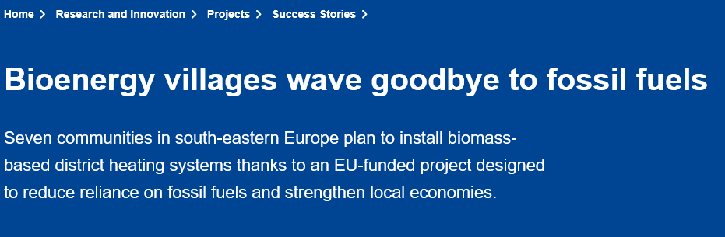
How does the EC support beneficiares?
Example 1 - Communication
https://ec.europa.eu/research/infocentre/article_en.cfm?&artid=51125&caller=FP

Slide 11
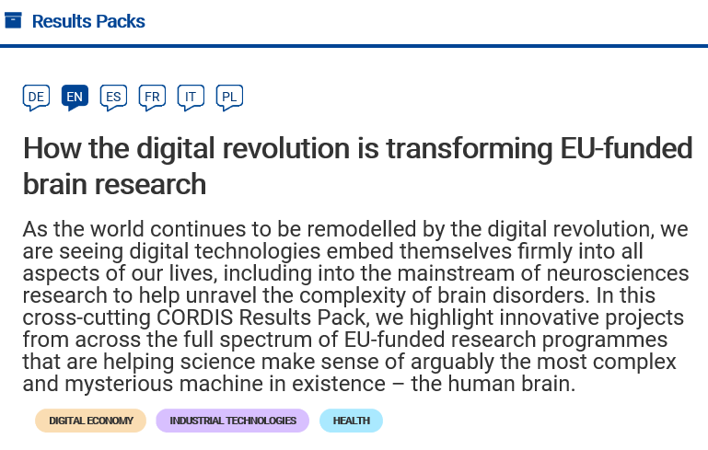
How does the EC support beneficiares?
Example 2 - Dissemination
https://cordis.europa.eu/article/id/401587-cordis-results-pack-on-the-brain/en

Slide 12

How does the EC support beneficiares?
Example 3 – Dissemination/Exploitation
Two Pilots: Common Disseminaton & Exploitation Boosters (Framework contracts)
From 2016-2019: tailored services to projects to help them bridge research with the market
Budget: EUR 2.2 million
Successor: D&E Booster
The call was launched in September (no deadline)
Types of services: (i) Portfolio Dissemination & Exploitation Strategy; (ii) Business Plan Development; (iii) Go-To-Market assistance
Budget: EUR 12 million

Slide 13
Why does it not always happen?
From the side of the project/beneficiaries
Lack of capacity or skills
Focus on scientific work and not so much on how this can benefit end users
Interpreted as an activity after the project lifetime
Not truly part of the overall project design
From the side of the Commission
The current reporting on D&E may not be fit for the purpose
Limited follow up on the project results after the end of the project

Slide 14
C&D&E in Horizon Europe
C&D&E remains key in FP implementation
C&D&E in Horizon Europe
Better C&D&E
More Impact
Improved value
of R&I funding*
…and we have to ensure it
Dissemination is a specific objective for all measures
C&D&E in FP
  Information, communication, publicity and D&E
  Calling for a comprehensive D&E strategy
FP and SP annexes on D&E
  Demonstrate the impact and maximise the European added value of the FP
  Dissemination of clusters of mature results to EU regions
  Accelerate exploitation towards market uptake
  Delivery mechanism
  Contractual obligations of beneficiaries for C&D&E reporting during and after the project
  Encourage the third party exploitation

Slide 15
C&D&E orientations in Horizon Europe
Focus on strengthening the link between science and society
Outreach activities addressing novelties of Horizon Europe
Enhanced communication with National Contact Points (NCPs)
Enhanced reporting and data collection for supporting the D&E objectives
Introducing a feedback to policy framework for translating R&I results into policy making & programming

Slide 16
C&D&E orientations in Horizon Europe
Encouraging third party exploitation (where appropriate)
Emphasis on continuous reporting on D&E (even after the end of the project)
Improvements on the proposal/reporting template to introduce more specific language on D&E
Fostering synergies with other EU programmes and initiatives
Introducing incentives for exploitation, provide support to beneficiaries through existing tools for increasing the use of their results

Slide 17
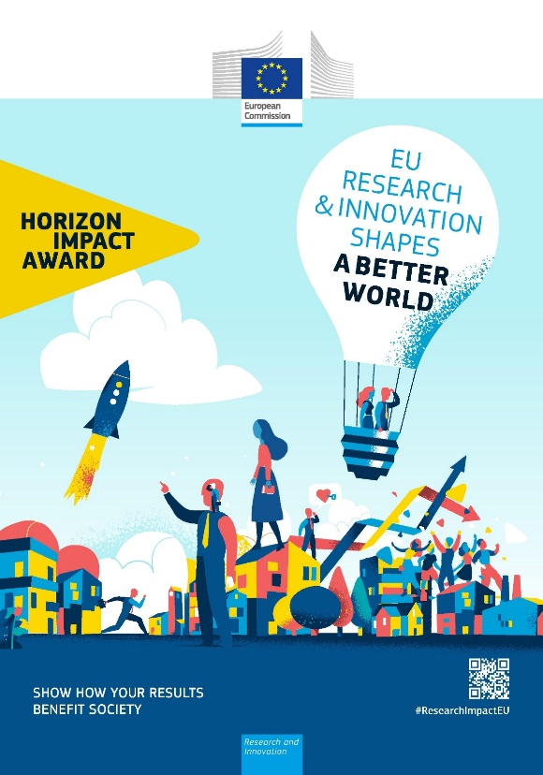
Incentives for exploitation – a recent example
C&D&E orientations in Horizon Europe
Horizon Impact Award contest
First of its kind to celebrate and recognise projects with demonstrated impact on society
The applicants had to showcase how they transformed their results into concrete outcome

Slide 18

Enhanced D&E support to beneficiaries – a new initiative
C&D&E orientations in Horizon Europe
Horizon Results Platform
Results are presented in visually attractive way (e.g. videos), and optionally with more in-depth content references
Beneficiary-driven
Beneficiaries can demonstrate their needs to ‘unblock’ them from scaling up their results

Slide 19
Horizon Results Platform
C&D&E orientations in Horizon Europe
Integrated with Innovation Radar
Integrated with the D&E Booster services
Integrated with a targeted dissemination strategy

Slide 20
Open Science in Horizon Europe

Slide 21
What is the general orientation?
Open Science as modus operandi for science in the FP
Towards a more open, collaborative, data-intensive and networked way of conducting research and sharing research results, enabled by developments in ICT and related infrastructures and the increasing proliferation of data

Slide 22
Open Access to publications in Horizon Europe
Open access via repositories kept but made immediate
Copyright retention
Publication in hybrid journals allowed (but costs not eligible)

Slide 23
Open Access to Research data in Horizon Europe
Mandatory Data Management Plan
FAIR principle
Open by default (exceptions will apply)
European Open Science Cloud

Slide 24
Key impact pathways in Horizon Europe

Slide 25
Key Impact Pathways
The KIPs will aim to:
Tell the story of the progress of the Programme as a whole, according to its objectives
Monitor progress at any moment in time (short-term, mid-term, long-term)

Slide 26
Key Impact Pathways
In this process, we need to :
Know who the individual researchers are (e.g. through unique identifiers)
Track the FP outputs better, through a structured reference to the funding source in publications, patents and other IPR applications
Make more use of available data and links to relevant existing databases so as to minimise the administrative burden of beneficiaries

Slide 27



The 9 KIPs
1. Creating high-quality new knowledge
Scientific
Impact
2. Strengthening human capital in R&I
3. Fostering diffusion of knowledge and Open Science
4. Addressing EU policy priorities & global challenges through R&I
Societal
Impact
5. Delivering benefits & impact via R&I missions
6. Strengthening the uptake of R&I in society
Economic/
Technological
Impact
7. Generating innovation-based growth
8. Creating more and better jobs
9. Leveraging investments in R&I

Slide 28
Take away messages
Increased emphasis on Dissemination & Exploitation for fostering the visiblity, availability, use, uptake and valorisation of R&I results
Open Science as modus operandi for enhancing knowledge circulation
Key Impact Pathways for more efficient and effective Programme monitoring

Slide 29
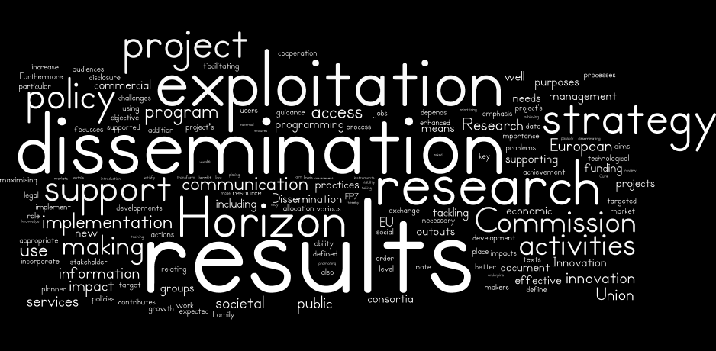
Thank you !

